Slide 1
Collective Worship
Our values and culture
January 2024

Slide 2
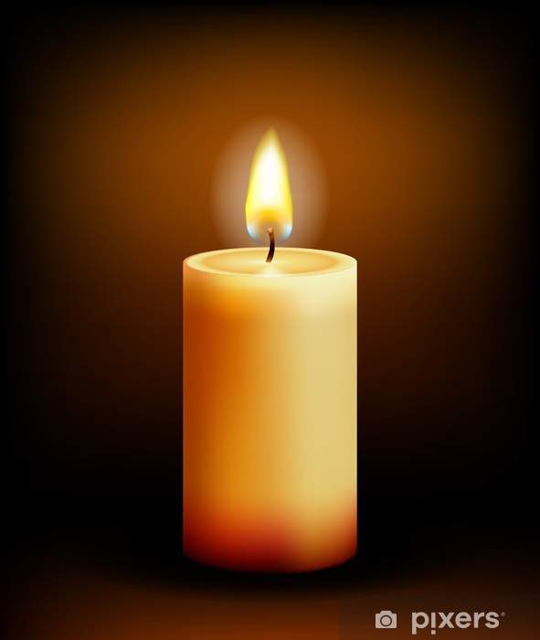
We light our candle on our sacred sPACE TO SHOW US THAT JESUS IS THE LIGHT OF THE WORLD AND HE IS ALWAYS WITH US.
Amen

Slide 3


Slide 4
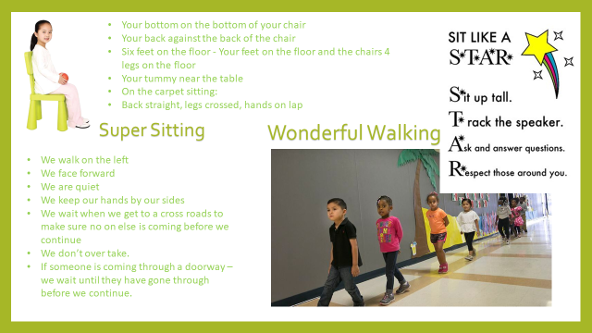
What does it say in the bible?
Notes:
.

Slide 5
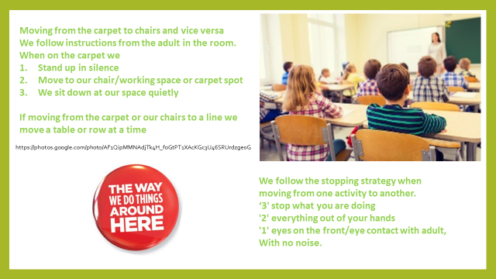

Slide 6

Notes:
How may of you have moved home since you were born?
How many of you have moved country?

Slide 7
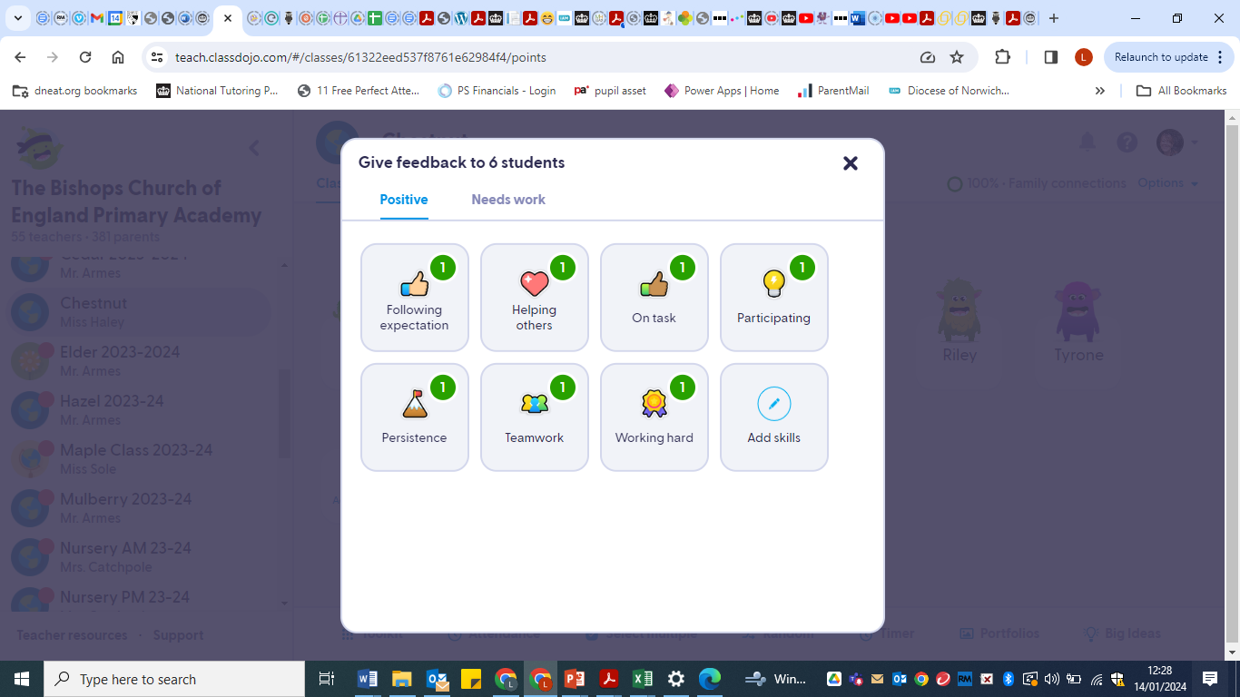
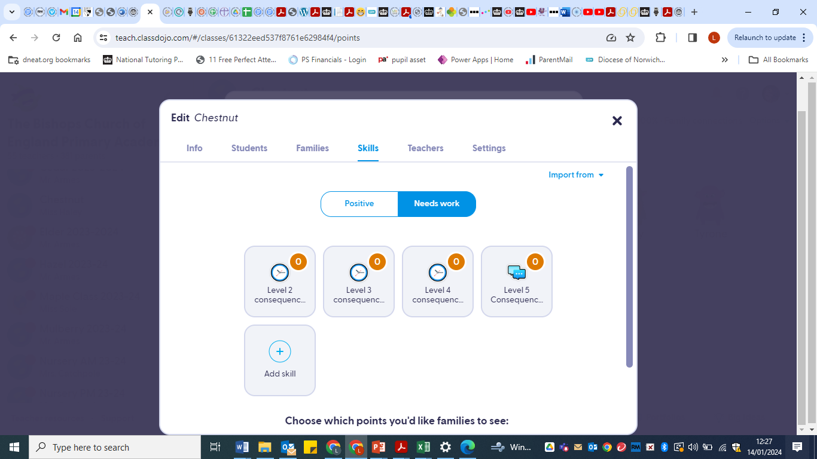

Slide 8


Slide 10

While we might blow out the candle at the end of each worship
Let us pray
Jesus, Help us to make the right choices so that we can have a happy and successful future.
Help us to follow the school’s values and treat others with kindness and respect.
Help us to know that when things go wrong, there are others who can help us. We can learn from our mistakes and make better choices in the future.
We thank you for all of the adults in our lives who keep us safe and help us when we need it. Help us to accept their help and to learn from the experience.
In your name
AMEN
The light of Jesus stays with us always.

Slide 11

May the grace of our Lord Jesus Christ, and the love of God, and the fellowship of the Holy Spirit be with us all, now and evermore.
Amen.

