Slide 1
Collective Worship
introducing Moses
January 2024

Slide 2

We light our candle on our sacred sPACE TO SHOW US THAT JESUS IS THE LIGHT OF THE WORLD AND HE IS ALWAYS WITH US.
Amen

Slide 3

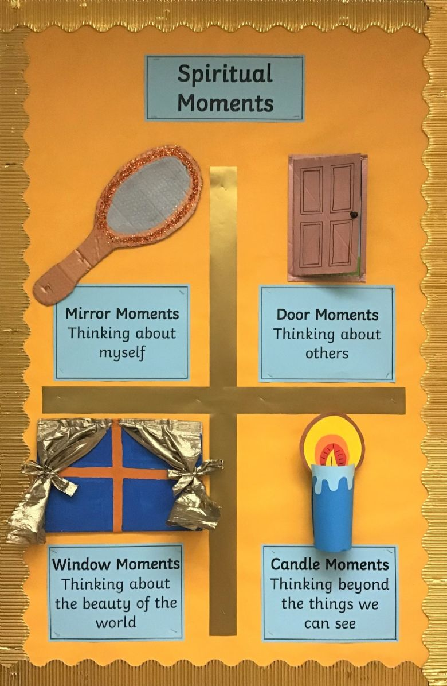
Let’s have a recap
Our school’s special story is The Good Shepherd and how we follow this story of Jesus to have Safe, Happy, Learning.
Just like we eat and drink to have healthy bodies, we also have opportunities to be spiritual. Spirituality is like water, it keeps our minds and hearts healthy.
We are spiritual when we have chance to reflect and think
Mirror – when we think about ourselves and our feelings
Windows – when we learn about others and think about them
Doors – when we learn something which makes us take action
Candles – when we pray or think about our relationship with nature, the world or God.
Can you spot the moments of spirituality each day?

Slide 4
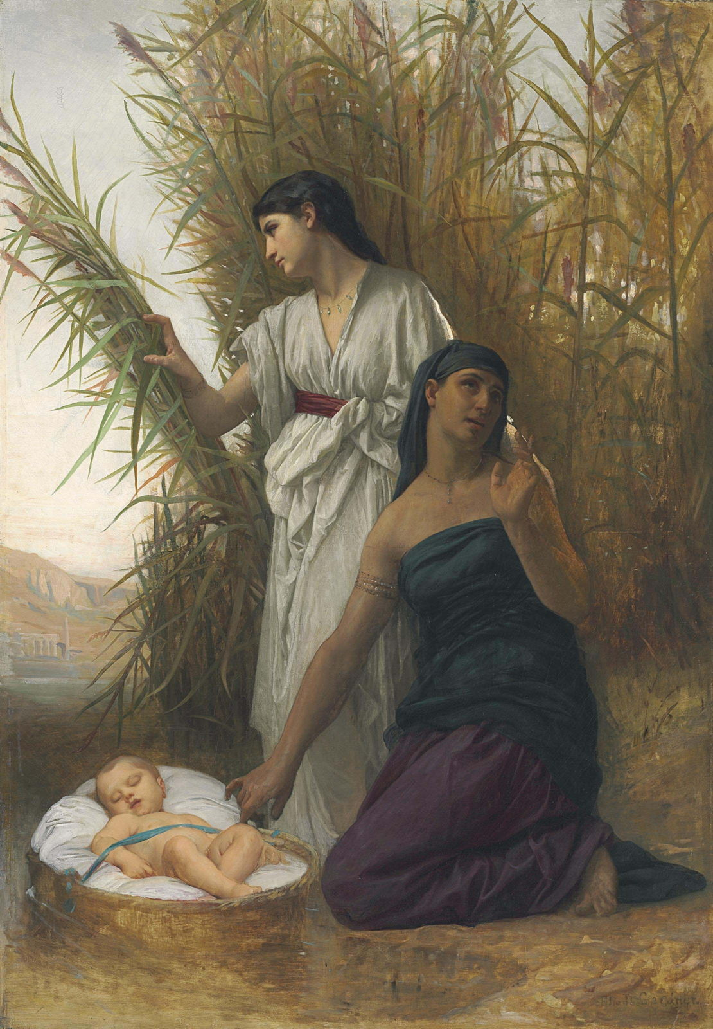


Slide 5
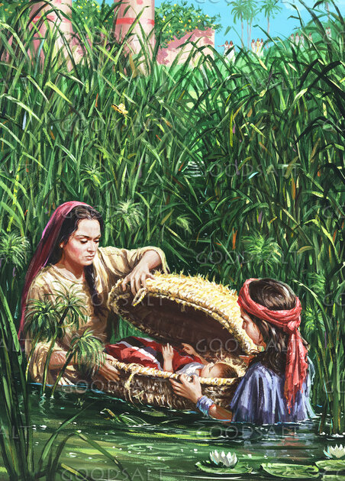
Moses as a baby
1 A man of the house of Levi went and took a daughter of Levi as his wife. 2 The woman conceived, and bore a son. When she saw that he was a fine child, she hid him three months. 3 When she could no longer hide him, she took a papyrus basket for him, and coated it with tar and with pitch. She put the child in it, and laid it in the reeds by the river's bank. 4 His sister stood far off, to see what would be done to him.
5 Pharaoh's daughter came down to bathe at the river. Her maidens walked along by the riverside. She saw the basket among the reeds, and sent her handmaid to get it. 6 She opened it, and saw the child, and behold, the baby cried. She had compassion on him, and said, "This is one of the Hebrews' children." 7 Then his sister said to Pharaoh's daughter, "Should I go and call a nurse for you from the Hebrew women, that she may nurse the child for you?" 8 Pharaoh's daughter said to her, "Go." The maiden went and called the child's mother. 9 Pharaoh's daughter said to her, "Take this child away, and nurse him for me, and I will give you your wages." The woman took the child, and nursed it. 10 The child grew, and she brought him to Pharaoh's daughter, and he became her son. She named him Moses, and said, "Because I drew him out of the water
Notes:
The story of the baby in the bulrushes is a story of courage. Egypt had just had a new Pharaoh or King. The Pharaoh was really scared of the Israelites and so he tried to do all he could to stop them from growing in number - he turned them all into slaves to build his cities and he treated them really badly. However the Israelites continued to increase in number, so the Pharaoh did the only thing he could think of, he ordered that all baby boys should be killed as soon as they are born. So when Moses was born his mother hid him away for as long as she could. She hid him for 3 months and then she does something very brave. She weaves a basket and puts Moses in the basket and puts him in the river Nile. Moses' mother had no way of knowing what would happen to him but she knew that it was the only way that he might survive. The baby's sister went with her mother to hide baby Moses. When Miriam's mother left Moses in the basket, Miriam stayed with her brother because she wanted to keep him safe and see what would happen to him. When Miriam saw that the princess had found her brother, and her brother was safe she could have gone home, but she wasn't ready to let him go just yet. Miriam then went and spoke to the Princess and asked if she would like Miriam to find someone to take care of the baby. Miriam's quick thinking meant that Moses was brought up by his own mother and was taught about God until he was old enough to go and live in the palace. Even the princess showed bravery. She knew the baby was an Israelite boy who should have died, but she took him in anyway. Bravery is really important in life it's what makes us able to face new things and things that we can't control. God gives us bravery in all that we do if we ask for it in prayer.

Slide 6
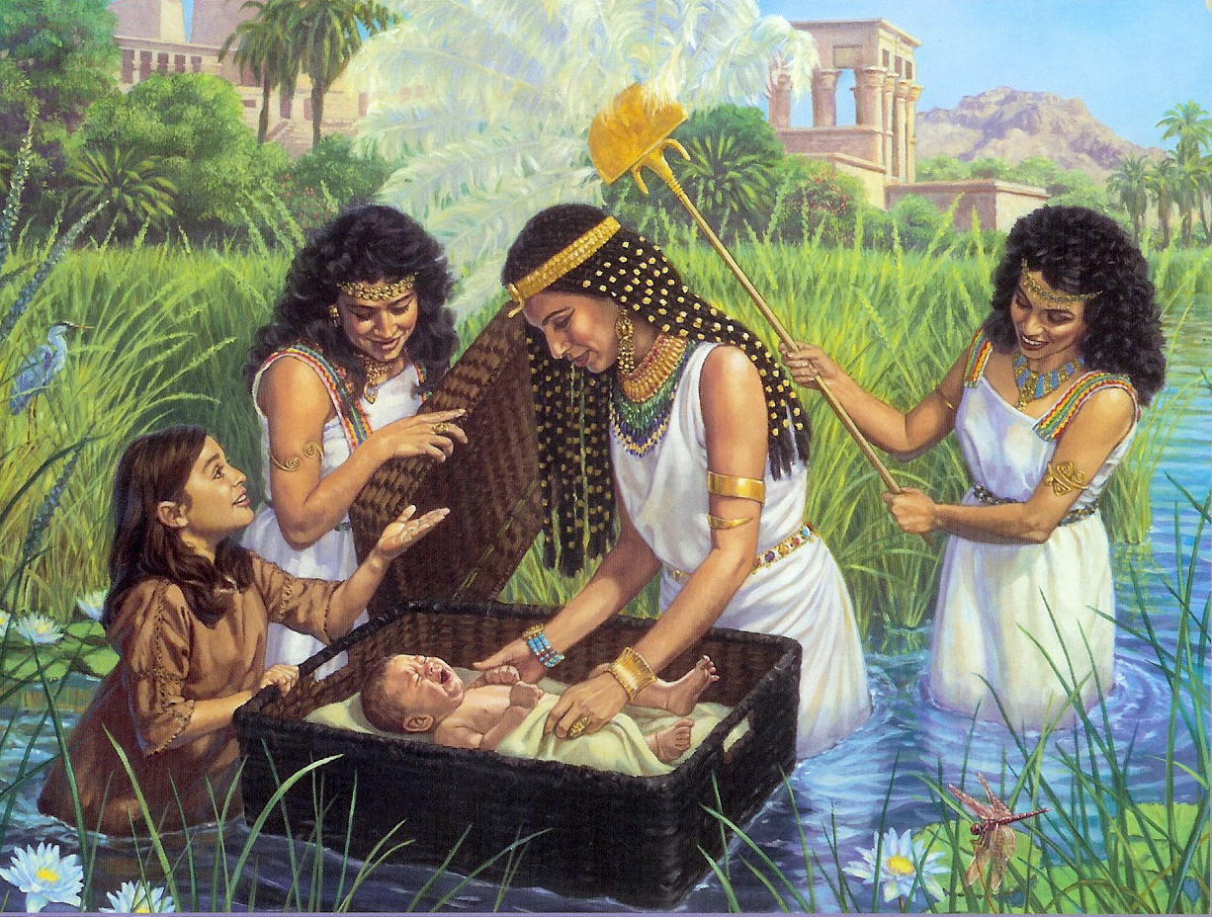
Let’s see the story of Moses
https://www.youtube.com/watch?v=J5kDffRBImc

Slide 7

While we might blow out the candle at the end of each worship
Let us pray
God give us the courage to make the right decisions, even when things are difficult and I feel as if everything is going wrong.
We know that you will always be with us, especially when we feel sad or confused and things are going wrong.
In Jesus’ name
AMEN
The light of Jesus stays with us always.

Slide 8

May the grace of our Lord Jesus Christ, and the love of God, and the fellowship of the Holy Spirit be with us all, now and evermore.
Amen.

