Slide 1
Collective Worship
The life of Moses: a path through the red sea
February 2024

Slide 2

We light our candle on our sacred sPACE TO SHOW US THAT JESUS IS THE LIGHT OF THE WORLD AND HE IS ALWAYS WITH US.
Amen

Slide 3
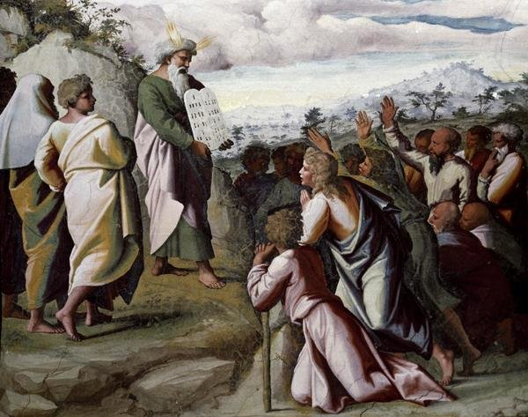


Slide 4
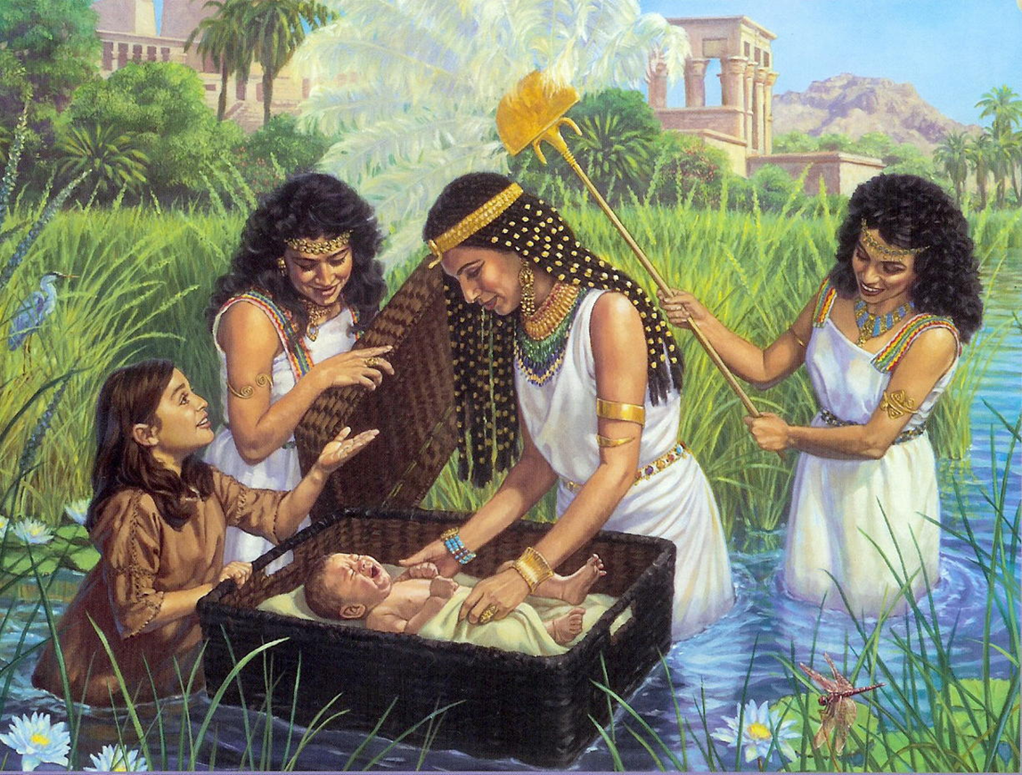

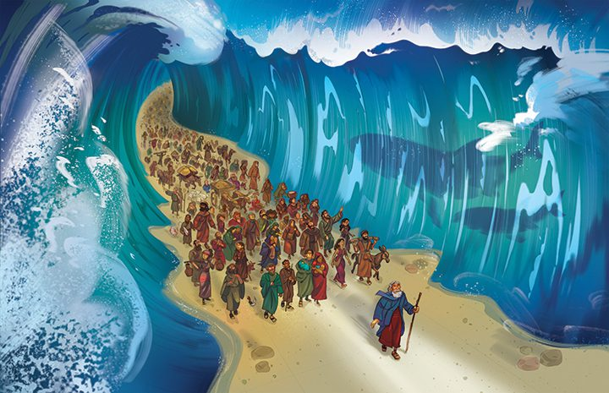
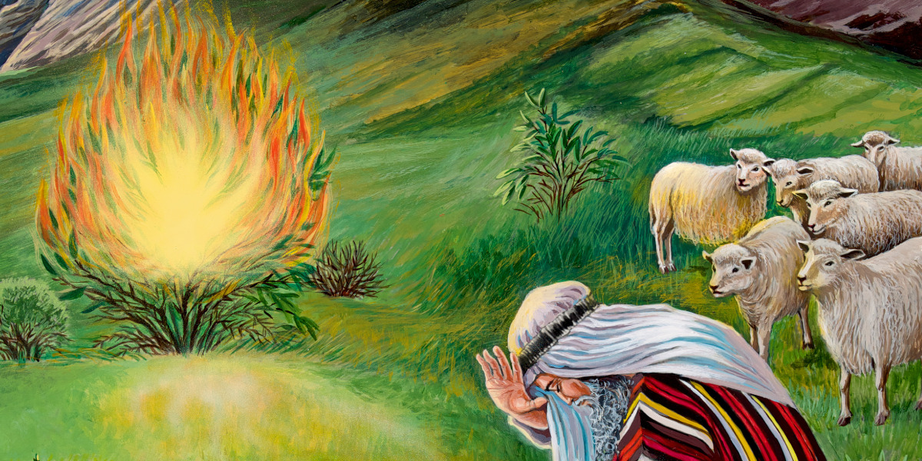
The story so far
Can you remember what happened to Moses?

Slide 5
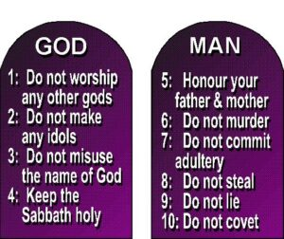
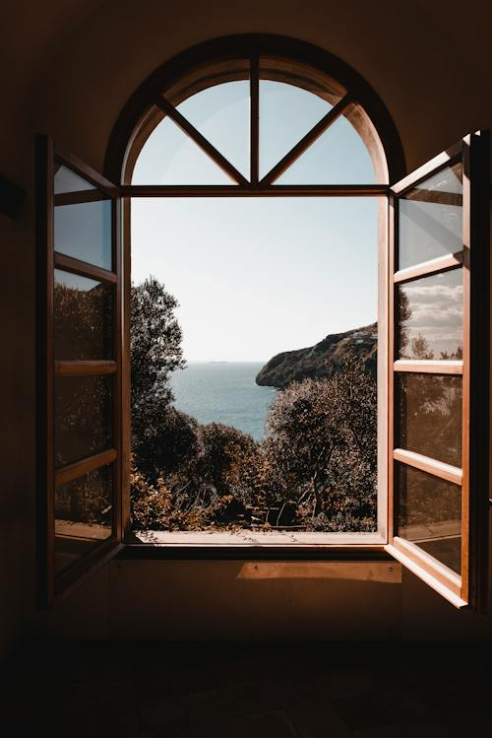
Let’s see the next story of Moses
https://www.youtube.com/watch?v=J5kDffRBImc
Notes:
Moses and the Israelites believed that God would save them from the Egyptians who wanted to keep them as slaves or to harm them to stop them from growing too powerful.

Slide 6

While we might blow out the candle at the end of each worship
Our Father in heaven, hallowed be your name, your kingdom come, your will be done,
on earth as in heaven.
Give us today our daily bread.
Forgive us our sins as we forgive those who sin against us.
Lead us not into temptation but deliver us from evil.
For the kingdom, the power, and the glory are yours now and forever.
Amen.
The light of Jesus stays with us always.

Slide 7

May the grace of our Lord Jesus Christ, and the love of God, and the fellowship of the Holy Spirit be with us all, now and evermore.
Amen.

