Slide 1
Collective Worship
The period of Lent
February 2024

Slide 2

We light our candle on our sacred sPACE TO SHOW US THAT JESUS IS THE LIGHT OF THE WORLD AND HE IS ALWAYS WITH US.
Amen

Slide 3
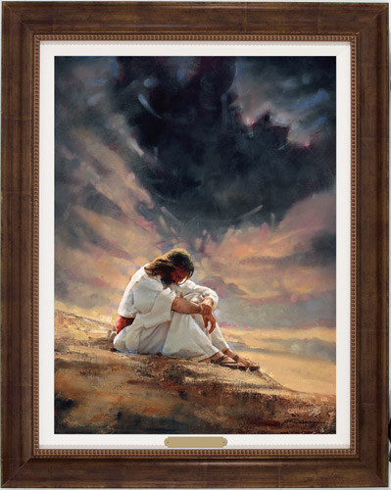


Slide 4

Journeys
What must it feel like to start out on a long journey?
How would you feel if God spoke to you and sent you on a journey?
We have just learned the story of Moses.
How did Moses feel when God spoke to him and said he needed to journey back to Egypt or when he needed to take the Israelites to their promised land?
How did the Israelites feel?

Slide 5
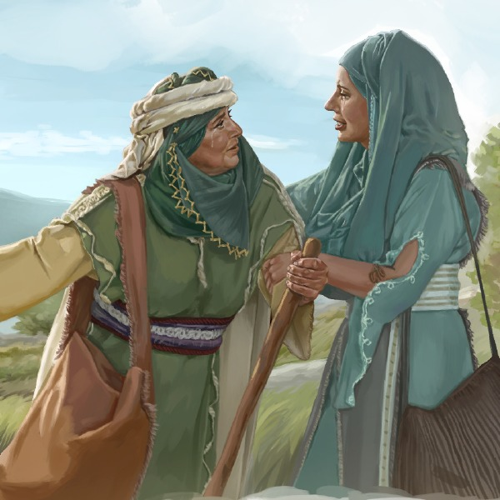
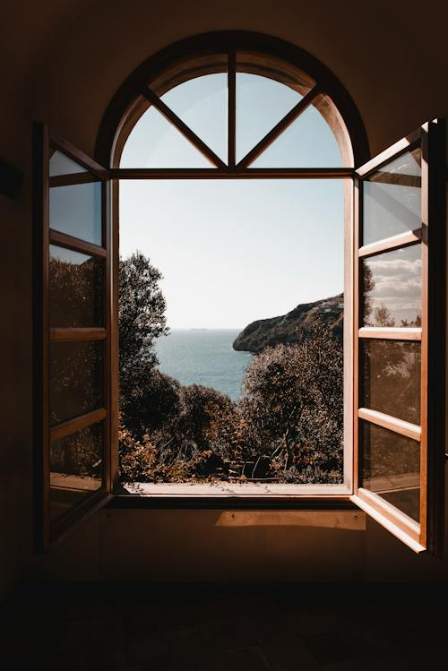
There are many stories of God asking people to travel,
Jesus travelled in to the wilderness for 40 days and nights. He wanted to be alone to reflect.
We are going to learn a new story from the Bible today. The story of Ruth and Naomi.

Slide 6

While we might blow out the candle at the end of each worship
Faithful God, Travel beside us as we go about our daily journeys.
We pray for all those who are travelling across the world at this time, especially those affected by war or lack of food.
Guide all our steps and bring us all to our destinations safely.
We ask this in Jesus’ name
Amen.
The light of Jesus stays with us always.

Slide 7

May the grace of our Lord Jesus Christ, and the love of God, and the fellowship of the Holy Spirit be with us all, now and evermore.
Amen.

