Slide 1


Gathering
We light our candle to show that Jesus is the light of the world and he is always with us.

Slide 2
Welcome to Collective Worship
Today is a special day

Slide 3

Shrove Tuesday and Ash Wednesday

Slide 4




Shrove Tuesday (Pancake Day)
Notes:
Shrove Tuesday is a cheerful celebration because it means that winter is nearly over and
warmer days are just around the corner. It is a time when Christians say sorry for all the
things they have done wrong before the start of Lent.

Slide 5
Today is Shrove Tuesday, Shrove means to say sorry for all the things you have done, realising that it was because of all the bad things we had done that God sent Jesus to forgive us.
Notes:
Shrove Tuesday is a cheerful celebration because it means that winter is nearly over and
warmer days are just around the corner. It is a time when Christians say sorry for all the
things they have done wrong before the start of Lent.

Slide 6
What do I need to make pancakes?
Notes:
Shrove Tuesday is a cheerful celebration because it means that winter is nearly over and
warmer days are just around the corner. It is a time when Christians say sorry for all the
things they have done wrong before the start of Lent.

Slide 7

What do we know about Lent?
Notes:
It marks the period of 40 days before Easter. In this time we think about Jesus, now he
has grown up (no longer the baby we met at Christmas). Aged 30 and at the start of
doing the work that God wanted him to do, he went into the desert for 40 days and 40
nights. In all that time Jesus did not have any food to eat.
How many of you come home at teatime saying ‘I’m starving’ even though you had lunch a few hours earlier – and probably a biscuit in between lunch and tea!

Slide 8
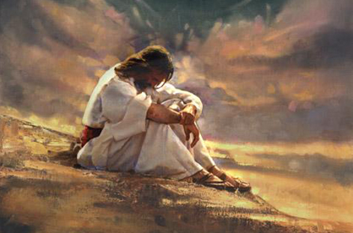
Forgiveness
Perseverance
Courage
Service
Notes:
To remember Jesus going without food, Christians have traditionally made Lent a time of fasting, of going without. A lot of people give something up for Lent.
Do you know anyone who has?
Perhaps you have?
Chocolate is a favourite thing to give
up nowadays. Traditionally, it was eggs, butter,
milk and meat.

Slide 9





What did Jesus give up?
Notes:
It marks the period of 40 days before Easter. In this time we think about Jesus, now he
has grown up (no longer the baby we met at Christmas). Aged 30 and at the start of
doing the work that God wanted him to do, he went into the desert for 40 days and 40
nights. In all that time Jesus did not have any food to eat.
How many of you come home at teatime saying ‘I’m starving’ even though you had lunch a few hours earlier – and probably a biscuit in between lunch and tea!

Slide 10



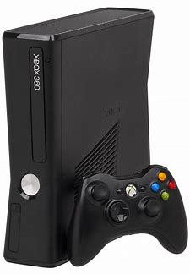
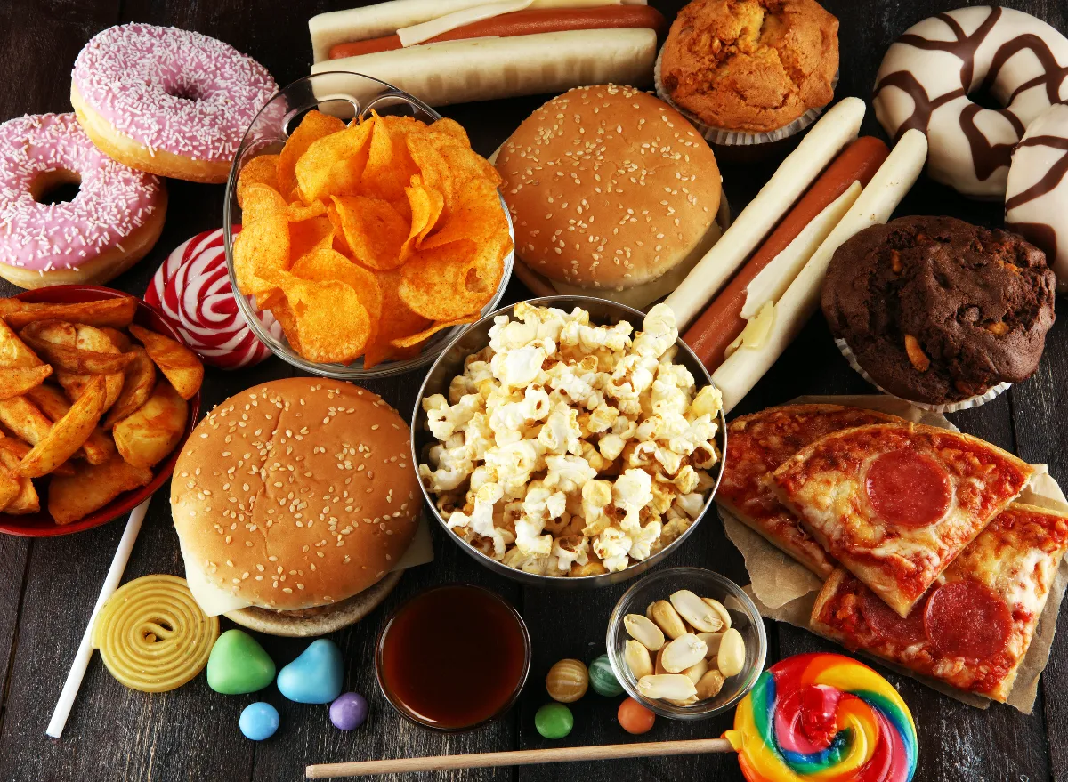


What might Christians give up?
Notes:
It marks the period of 40 days before Easter. In this time we think about Jesus, now he
has grown up (no longer the baby we met at Christmas). Aged 30 and at the start of
doing the work that God wanted him to do, he went into the desert for 40 days and 40
nights. In all that time Jesus did not have any food to eat.
How many of you come home at teatime saying ‘I’m starving’ even though you had lunch a few hours earlier – and probably a biscuit in between lunch and tea!

Slide 11
Reflection
However saying sorry is not enough if you then go and do the same thing again – and again
the next minute or the next day. Have you ever had a fight with your brother, said sorry when
you hurt him, and then hit him again 5 minutes later? I think it means you weren’t really sorry
the first time. So I want you to think about something you do that keeps on getting you in
trouble. It could be fighting with your brothers or sisters, not keeping your room tidy, talking to
your friends when you should be listening to your teachers, or anything.
Whatever it is I want you to think about giving
that thing up for Lent and beyond and truly
saying sorry.

Slide 12

Prayer for the start of Lent
I’m sorry when I’m unkind and when I forget to say thank you,
I’m sorry when I don’t take care of my toys or when I don’t want to share them.
I’m sorry for sometimes being naughty and then pretending it wasn’t me.
I’m sorry for not being careful and for sulking at bedtime.
I’m sorry when I forget that you love me all the time.
Thank you that when we say sorry you will forgive us because of Jesus. Amen.

Slide 13
Sending
While we blow out the light, Jesus remains with us always.

