Slide 1
Collective Worship
the nativity story - Epiphany
January 2024

Slide 2
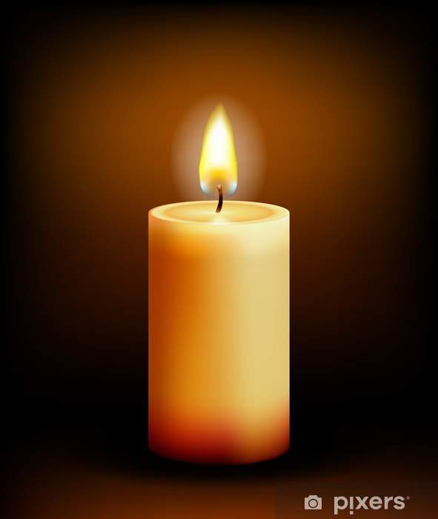
We light our candle on our sacred sPACE TO SHOW US THAT JESUS IS THE LIGHT OF THE WORLD AND HE IS ALWAYS WITH US.
Amen

Slide 3
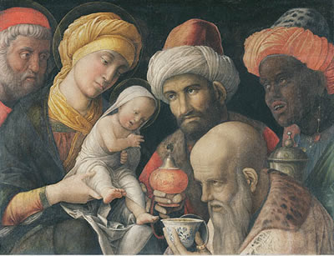

Slide 4
What does it say in the bible?
In the gospel of Matthew, we hear the story of how some wise men from another part of the world were led by a star and travelled the long journey to Bethlehem, looking for Jesus. They found him in a stable.
In the Gospel of Mark it says: “After Jesus had been born at Bethlehem in Judaea during the reign of King Herod, some wise men came to Jerusalem from the east... And suddenly the star they had seen rising went forward and halted over the place where the child was. The sight of the star filled them with delight and going into the house they saw the child with his mother Mary and falling to their knees they did him homage. Then, opening their treasures, they offered him gifts of gold, frankincense and myrrh.”
Notes:
Read section. Discuss that they visited the king Herod as they had expected that The king of the Jews would be born in a Palace. They asked him where the baby was but he did not know. He sent for his wise men and asked them about the phrophecy. They sent the wise men to Bethlehem to see the new born king but Herod asked them to return to him afterwards to tell him where he was as they would like to worship him as well.
The King Herod was jealous and did not want there to be another King but him! He had no intention of worshipping Jesus and wanted to harm him.
Fortunately the wise men were visited by angels in a dream. They told the wise men of the danger and not to return to Herod so the wise men returned home a different way.

Slide 5
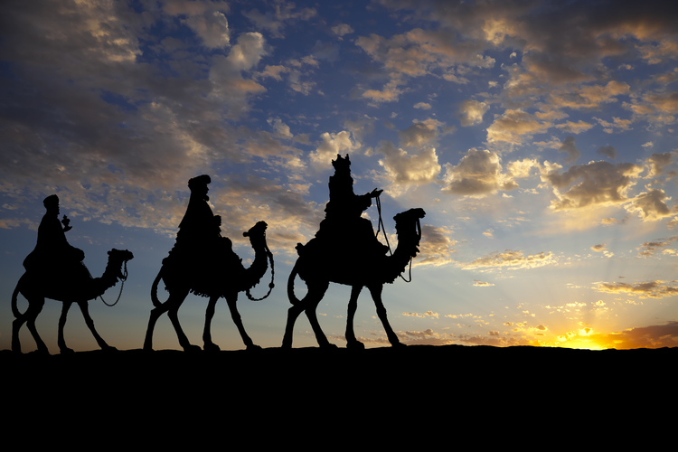
Epiphany
Notes:
Epiphany means to show – to reveal. What might be being revealed?
It is celebrated on the 6th January or the closest Sunday.
Magi were mentioned in the bible and we often show them coming to the stable. However it is unlikely that they arrived until much later – in fact up to two years later.
Magi were unlikely to be kings. They were possibly wise men or astronomers. We don’t know how many travelled, it is likely that there were a number in the group as they would have travelled a long way. We know there were three gifts and that there were three named.
There were prophesies that the son of God would be born and that it would be shown by the star of Bethlehem. These magi had followed the movement of stars in the sky. The star has been seen again since the birth of Jesus but it is very rare. The last time it was seen was December 2020 but it won’t be seen again until 2080.

Slide 6
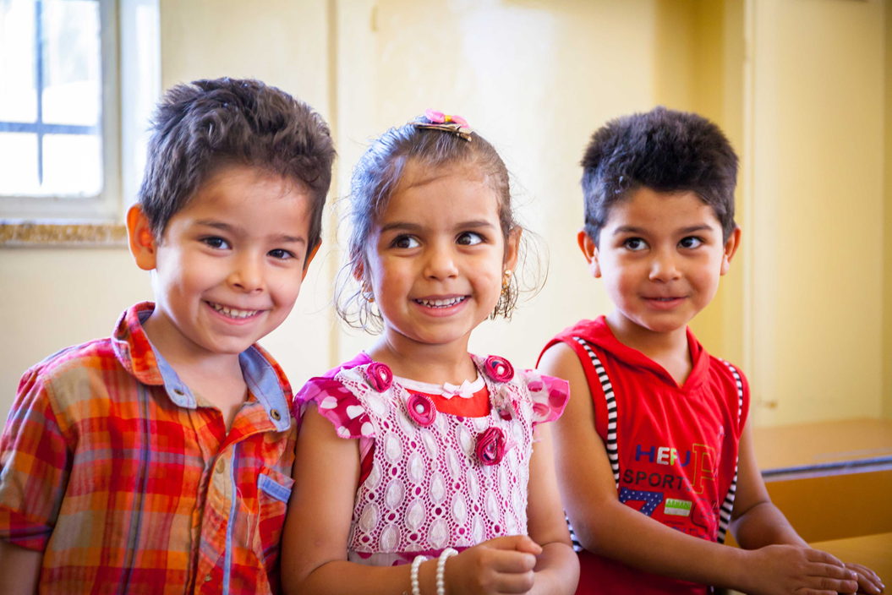

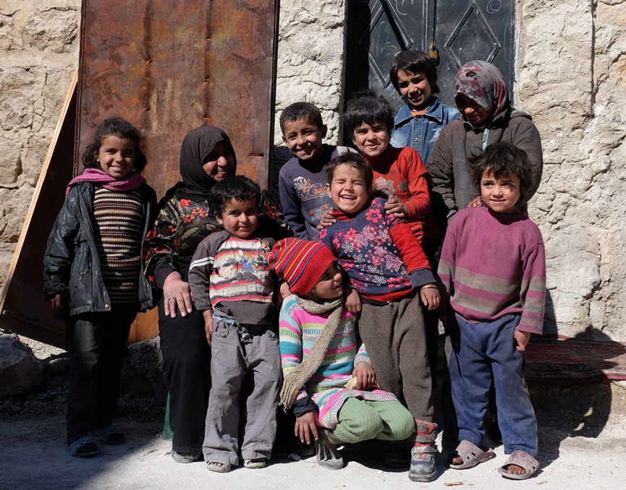
Why do people move country?
Mary and Joseph had to move to be registered and left Nazareth to go to Bethlehem where they stayed while Jesus was a baby.
Why else do people move country?
What do you think it feels like to move to another country?
What can we do to help people feel welcome?
Notes:
How may of you have moved home since you were born?
How many of you have moved country?

Slide 7

While we might blow out the candle at the end of each worship
Let us pray
Jesus, Guide on our journey, let us see with your eyes, so that we may recognise you in every person of every race, nationality and colour.
Jesus, Light of the world, may we be a light for those whose lives we share; may our kindness and care bring courage and hope to those who are sad.
Jesus, bringer of comfort, help us to realise that we have gifts to offer to you through your people every day, and these gifts are precious to you.
May we show our thanks through showing our kindness to all people around the world.
The light of Jesus stays with us always.

Slide 8

May the grace of our Lord Jesus Christ, and the love of God, and the fellowship of the Holy Spirit be with us all, now and evermore.
Amen.

