Slide 1
Collective Worship
Resilience and hope
January 2023

Slide 2

leader: God in Christ has revealed his glory
Response: Come let us worship.
We light our candle on our sacred space. May its light show us that the Holy Spirit shows us the right way.
Amen

Slide 3

Resilience and hope
Notes:
As we move beyond Christmas and the Epiphany we move into the next part of the Christian calendar and start thinking about making good choices, how to make sure we avoid temptation and move towards the period of lent and into the festival of Easter.
We are going to find out about the story of Joseph over the next few weeks. It is an exciting story we will learn bit at a time.

Slide 4
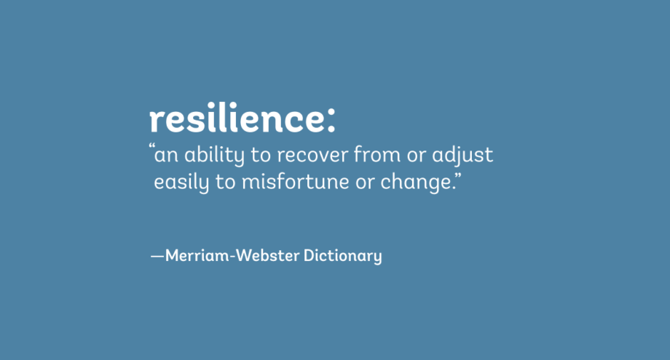
What is resilience?
RESILIENCE
Can you think of a time when you have shown resilience? When something was going wrong but you carried on and did not let it stop you. Or when you had been upset or hurt by something but bounced back even though you had been upset?

Slide 5


Slide 6
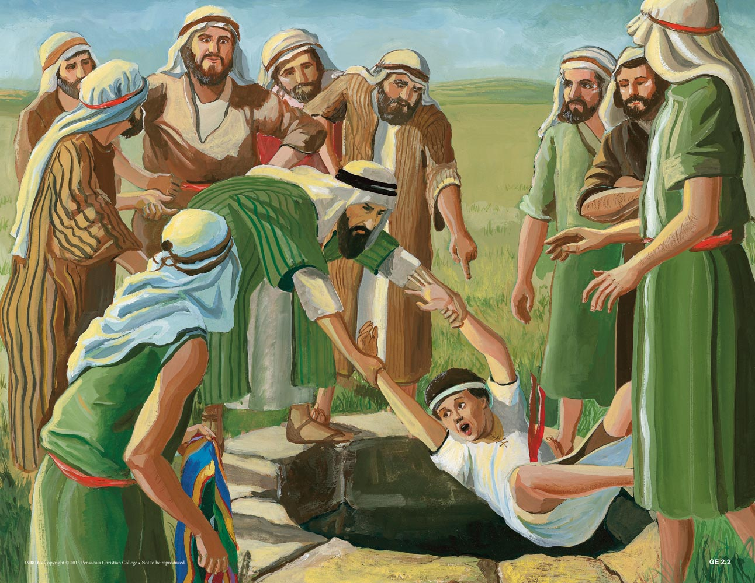
Over the next couple of weeks we are going to learn a story about a man called joseph . It is from a book in the old testament from the bible
Joseph was born into a family of 10 older brothers and at least one sister. Joseph became Jacob’s favourite son. This caused his brothers to envy and dislike him.
Joseph’s troubles reached a new level when he was 17.
After a series of dreams he had showed him that God would elevate Joseph over his brothers. He shared what hah happened in these dreams with his father and brothers. This made them dislike him even more!
They decided to get rid of him! They went out on a walk and threw him into a pit and left him for dead. But, as they were eating, a band of Ishmaelite traders passed by, so they decided to sell him into slavery for profit instead. Joseph was then taken to Egypt as a slave. His brothers led their father to believe that a wild animal had attacked and devoured Joseph.
His father was devastated and grieved for the death of his son.

Slide 7
The story of Joseph Part 2
Joseph eventually found himself working as a slave in the house of Potiphar, a man of high rank in Egypt.
Joseph served Potiphar well—with hard work, skill and honesty—and God blessed everything he was involved in. Potiphar eventually saw how Joseph’s work was blessed and made him overseer of his entire household (Genesis 39:1-6). An overseer was like a manager.
Things started to get difficult for Joseph. Potiphar’s wife became attracted to him and started to make daily advances toward him, wanting Joseph to spend time with her.
Joseph knew that she was married to Potiphar, who was his boss. He liked working for Potiphar and did not want to upset him. He knew that spending time with his wife could get him in a lot of trouble and would be against the law.
Joseph kept telling Potiphar’s wife that he would not spend time with her and was not interested in her.
She eventually trapped him and tried to force him to spend time with her by grabbing his clothes, but he ran away.
Realizing that Joseph had rejected her and was not going to be with her she was angry, she made up a lie about him to get him in trouble.
Instead of being rewarded for making good choices, Joseph was thrown in prison.

Slide 8
Joseph showed perseverance by making good choices, even though someone was making his life difficult.
They were trying to make him do something he did not want to do.
Even though he made the right choices – he still ended up in prison!
What do you think will happen next?
Do you think people will realise Joseph is a good person and had done nothing wrong?

Slide 9
Can you think of a time when someone tried to get you to do something you knew was wrong?
What did you do?

Slide 10
Let us pray
Dear God,
We thank you for giving us the freedom to make choices.
Sometimes it is hard to make the right choice and we need your help.
Some times people tempt us and try to make us do things we do not want to do.
Please help us to know what to do.
Help us to remember that we should make great choices all of the time –
Even when that is hard to do.
Amen

Slide 11

May the grace of our Lord Jesus Christ, and the love of God, and the fellowship of the Holy Spirit be with us all, now and evermore. Amen.

