Slide 1
Collective Worship
Resilience and hope
March 2023

Slide 2

leader: God in Christ has revealed his glory
Response: Come let us worship.
We light our candle on our sacred space. May its light show us that the Holy Spirit shows us the right way.
Amen

Slide 3
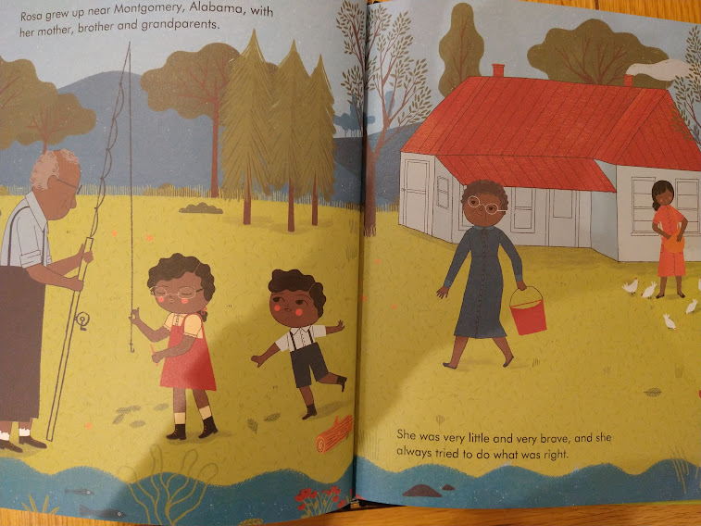

Slide 4


Slide 5
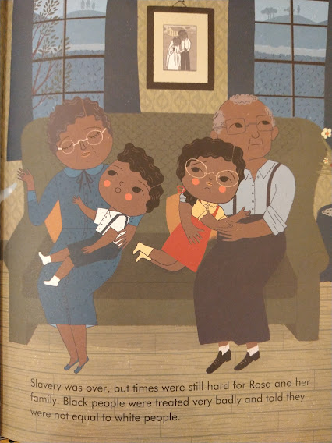

Slide 6
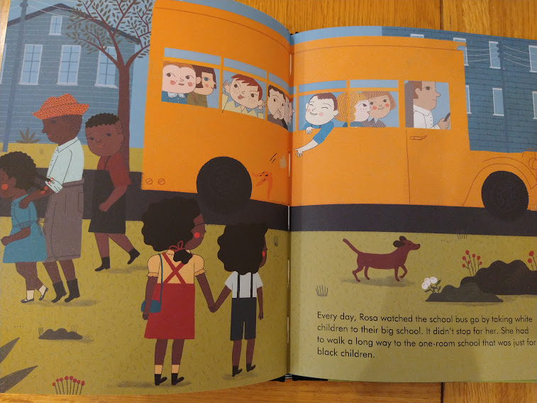

Slide 7


Slide 8
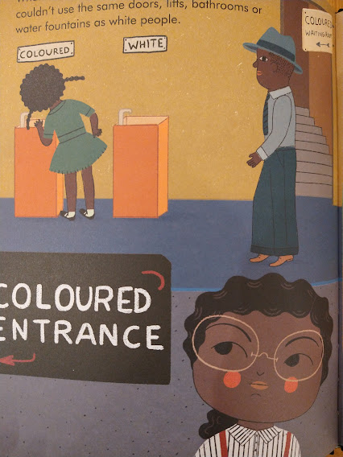

Slide 9
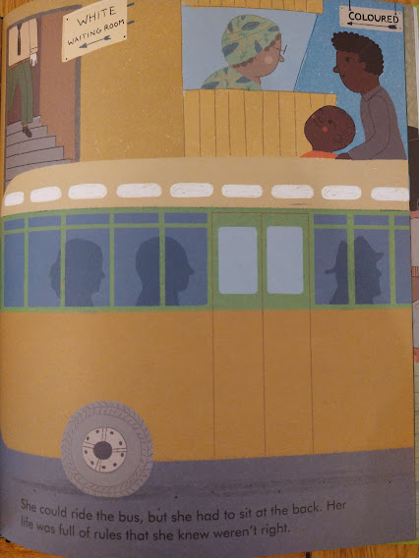

Slide 10


Slide 11


Slide 12
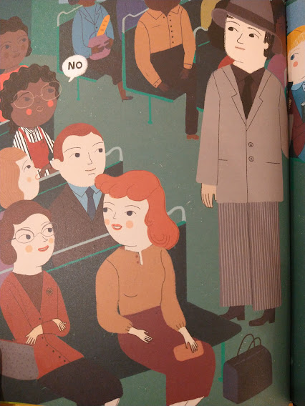

Slide 13


Slide 14


Slide 15
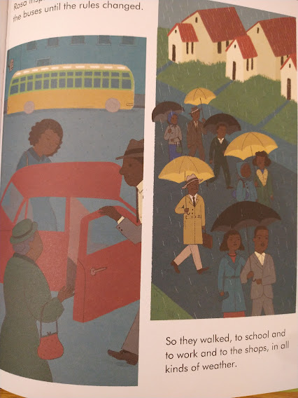
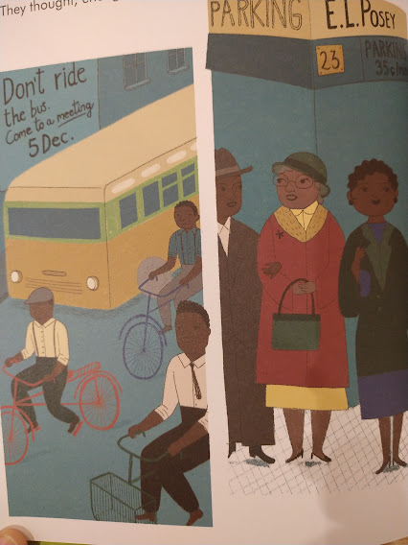

Slide 16
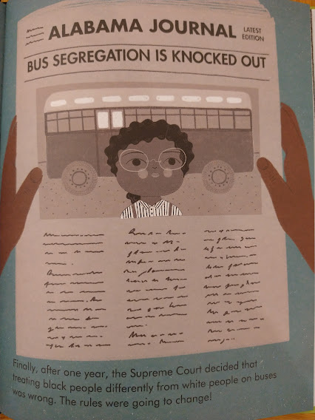

Slide 17
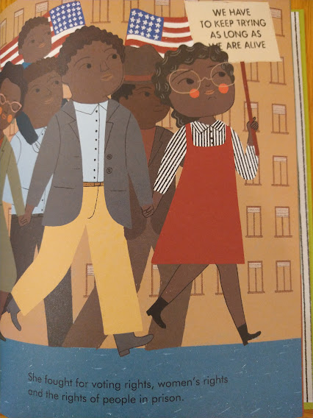

Slide 18


Slide 19
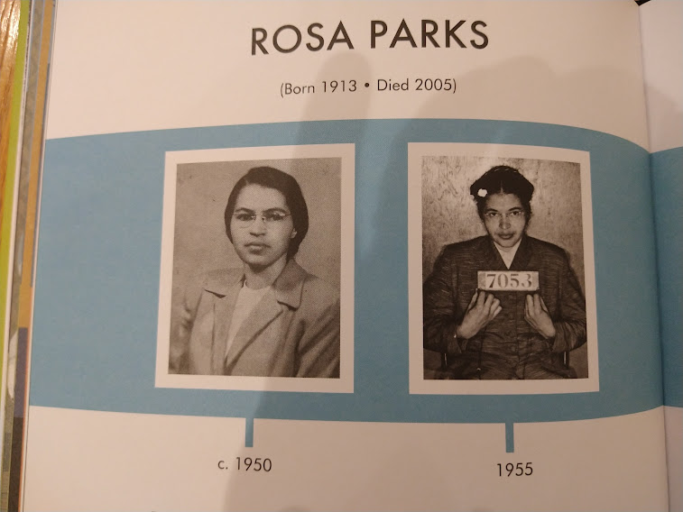

Slide 20
Let us pray
Dear God,
We thank you for giving us the freedom to make choices.
Sometimes it is hard to make the right choice and we need your help.
Help us to understand the impact of the choices we make and to know that we can make the world a better place to live in.
Just one person can make such a difference as did your Son Jesus Christ.
Please help us to know what to do.
Help us to remember that we should make great choices all of the time –
Even when that is hard to do.
Amen

Slide 21

May the grace of our Lord Jesus Christ, and the love of God, and the fellowship of the Holy Spirit be with us all, now and evermore. Amen.

